Slide 1
Making the case for moving SAP to the cloud
Your logo here
Your Name Here
Date

Slide 2
Contents
Slide 03 /
Slide 05 /
Challenges with SAP On-Premises
Why Move SAP to the Cloud?
Slide 08 /
Slide 10 /
The Benefits of Moving to the Cloud Today
Why Microsoft Azure for SAP in the Cloud
Slide 14 /
Slide 16 /
Journey to SAP HANA and Cloud
Appendix

Slide 3
Challenges with SAP On-Premises

Slide 4
The growing challenge of managing SAP on-premises
Manual/slow processes
Slow innovation
Poor insight
Manual tasks are expensive and slow down functions across the business.
The business is slow to innovate given the time it takes to experiment, set-up, and tear down IT infrastructure, resulting in long time to value.
Data lives in silos, moves slowly, and is not properly combined with non-SAP data to drive better decision making.
Notes:
Current infrastructure on-premises or hosted is highly pre-planned with 3-5 year planning cycles and is not built for today’s fast paced innovation cycles to launch and learn new applications or business processes in days.
Data sources are now varied and no longer just in your ERP. Data can be unstructured data from social, web or newer applications such as IOT in addition to applications that might be on non SAP stack. IT organizations are being asked to deliver insights across the entire organization which means IT needs to bridge these silos.

Slide 5
Why Move SAP to the Cloud?

Slide 6
SAP in the cloud can power better business processes, innovation, and insights
Faster, simpler processes
Accelerated innovation
360 insight
Scale up or down easily within minutes while having 24/7 business continuity and security built in, futureproofing for our S/4 HANA needs.
Accelerate innovation by removing barriers and time to set up systems, enabling fast experimentation –accelerating the build, measure, and learn cycle.
Generate compelling insights by aggregating SAP and non-SAP data to provide a 360° view of markets, transactions, and customers.

Slide 7
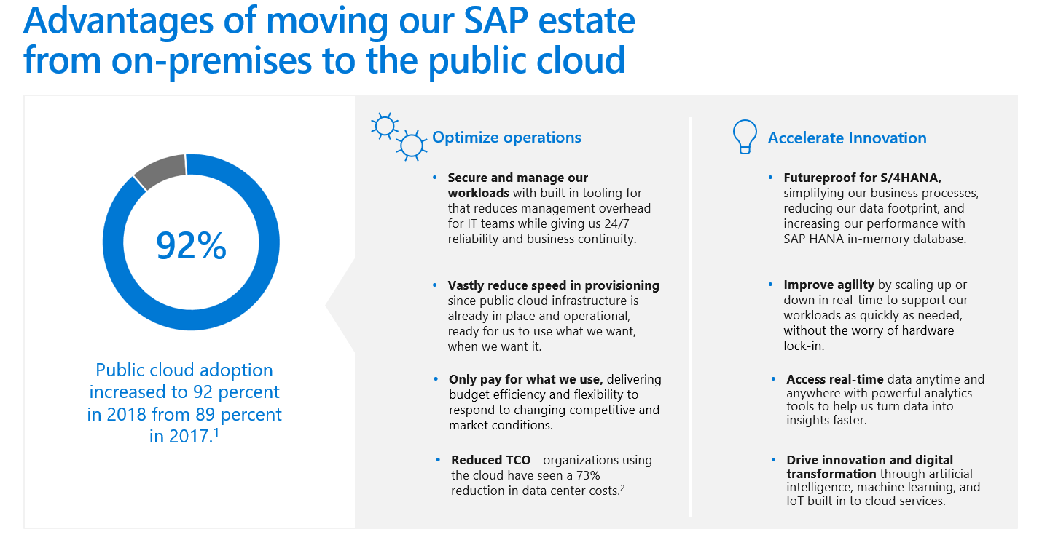
1. “Cloud Computing Trends: 2018 State of the Cloud Survey.” Rightscale. February 13, 2018. Retrieved October 28, 2018
2. The Total Economic Impact of Microsoft IaaS, a commissioned study conducted by Forrester Consulting on behalf of Microsoft, August 2017.

Slide 8


SAP’s roadmap to HANA is a good opportunity to move to the cloud now
Current
2021-2023
2025
SAP announces support ending for ECC.
Majority of users will migrate to S/4Hana.
SAP’s support for ECC ends, forcing all users to migrate to S/4HANA.
As of August 2018, 8,000 customers have chosen SAP S/4HANA.
Starting the migration now allows us to have more a more controlled, planful transition on our own terms.
Skilled resources will become increasingly unavailable as the bulk of users begin to migrate to S/4HANA.
Further customizations to the current implementation will complicate migration efforts and increase cost.
Business simplification is our driver for implementing SAP S/4HANA on Azure. We have improved visibility and control over key aspects of our enterprise.
— Sascha Wenninger: Technology Lead for the 4S program,
Orica

Slide 9
Why Microsoft Azure for SAP in the Cloud

Slide 10
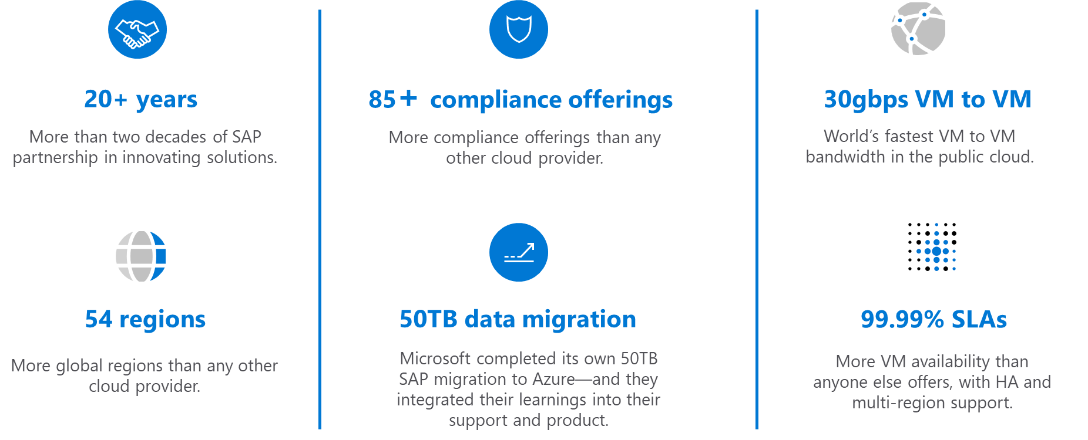
Benefits of using Azure as our SAP cloud provider
Notes:
See more details in the appendix.

Slide 11
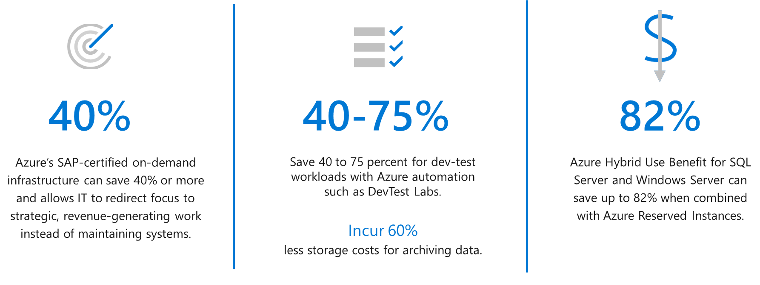
How SAP on Azure can help us reduce Total Cost of Ownership
Expensive over-capacity becomes a thing of the past, and the scale of cloud drives costs down over time.

Slide 12



SAP on Azure in action—a case study Explosives provider simplifies business and improves data access with SAP S/4HANA on Azure
Melbourne, Australia–based Orica, the global leader in mining and civil blasting, embarked on an extensive business process standardization project. It adopted a solution combining SAP S/4HANA and other SAP systems, all running on the Microsoft Azure cloud platform and safeguarded by Azure services. Months after deploying the first phase, the company is seeing business system simplification benefits. Along with IT efficiency gains as a byproduct, Orica has a solid base for the next phases in its global business system makeover.
Read the story
Microsoft Azure
Azure Active Directory
Azure Multi-Factor Authentication
Azure Site Recovery
Azure Write Accelerator
Microsoft SQL Server
11,500 employees
Mining, oil, and gas
Australia
Cognizant
Notes:
https://customers.microsoft.com/en-us/story/orica-mining-oil-gas-azure
See the appendix for additional case studies.

Slide 13
Journey to SAP HANA and Cloud

Slide 14


Journey to SAP HANA and Cloud
On-premises
Multi-Vendor
Lift and Shift to Cloud
SAP AnyDB on Azure
S/4HANA on Azure
A
Migration to HANA, Conversion to S/4HANA
Non-SAP,
Custom
SAP HANA on Azure
Analytics
B
Lift and Migrate to Cloud
Analytics
Non-SAP, Custom
Migrate to HANA
Non-SAP,
Custom
ERP,
Industry Add-ons
Industry solutions
Conversion to S/4HANA or BW/4HANA
Non-SAP
Analytics
Any DB
Embedded analytics
ERP,
Industry Add-ons
ERP,
Industry Add-ons
C
Lift and Shift/Migrate to Cloud, Migrate part to HANA
S/4HANA
HANA
D
Transformation to S/4HANA and Cloud: Consolidation or (selective) Re-implementation or Greenfield
Any DB
HANA
Notes:
There are different paths to migrate to SAP HANA and Azure, depending on your business needs.

Slide 15
Appendix
Final thoughts & resources

Slide 16
Final thoughts
We hope you found this PowerPoint template helpful for making the case to move SAP to the cloud with your business.
Microsoft is dedicated to being the best cloud provider for your SAP estate, and we hope you’ll choose Azure for your cloud platform. If you have any questions, please contact an Azure specialist, who will be happy to help.
Additionally, you’ll find more resources in this appendix, as well as on the SAP on Azure website.
We look forward to helping you run your SAP workloads on Azure’s secure, scalable, and enterprise-proven cloud platform.
Cheers,
The Microsoft Azure Team

Slide 17
Additional Resources
Read about 15 lessons learned from migrating SAP to the Cloud by downloading this e-book.
Check out customer stories about SAP on Microsoft Azure in this deck and view more on our website here.
Estimate the cost savings you can realize by migrating your workloads to Azure with a Total Cost of Ownership Calculator – start your assessment.
Get more resources on our SAP on Azure solution page.
We’re here to help! Contact an Azure specialist.

Slide 18
Case Studies
Case Studies | Company | Industry | Size
Daimler entrusts SAP HANA–based global procurement system to Microsoft Azure | Daimler | Manufacturing | 10,000+
Explosives provider simplifies business and improves data access with SAP S/4 HANA on Azure | Orica | Mining, Oil, and Gas | 10,000+
Dairy farmers use SAP on Azure to milk value from enterprise resource planning | Dairy Farmers of America | Consumer Goods | 1,000 – 9,999
Festo is running the first SAP production system on Microsoft Azure | Festo | Professional Services | 10,000+
Sanko Holding is growing its roots to the cloud throughout its digital transformation journey | Sanko Holding | Chemicals | 10,000+
Co-op rolls out data-driven business transformation using SAP on Azure | Co-op | Retailers | 1,000 – 9,999
Note: Many of these case studies have one-slide summaries you can leverage in your presentations, like this one. Check them out in the links above.
See more case studies about
SAP on Microsoft Azure.

Slide 19
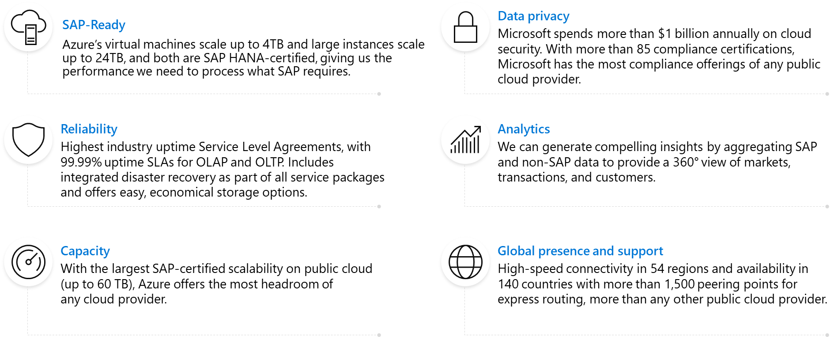
Our SAP solutions can take advantage of the robust Azure ecosystem

Slide 20




































With 85+ compliance offerings for SAP, Azure has more certifications than any other cloud provider—here are some of them:
GLOBAL
ISO 27001
ISO 27018
ISO 27017
ISO 22301
SOC 1 Type 2
SOC 2 Type 2
SOC 3
CSA STAR
self-assessment
CSA STAR
certification
CSA STAR
attestation
INDUSTRY
PCI DSS
level 1
CDSA
MPAA
FACT UK
Shared
assessments
FISC Japan
HIPAA / HITECH Act
HITRUST
GxP
21 CFR Part 11
MARS-E
IG Toolkit UK
FERPA
GLBA
FFIEC
REGIONAL
Argentina PDPA
EU
model clauses
UK
G-Cloud
China
DJCP
China
GB 18030
China
TRUCS
Singapore
MTCS
Australia
IRAP/CCSL
New Zealand
GCIO
Japan my
number act
ENISA
IAF
Japan CS mark gold
Spain
ENS
Spain
DPA
India
MeitY
Canada
privacy laws
Privacy
shield
Germany IT
Grundschutz
workbook

